Slide 1
Project 3:
Most Valued Data Science Skills
By Vyanna Hill and Tora Mullings
Notes:
vy

Slide 2
Agenda
Introduction into Careers in DS
How the project was produced
Our Findings
Conclusion
Notes:
vy

Slide 3
Motivation
“Today, data science is the backbone of any industry and current trends indicate that jobs in this domain will continue to grow over the next foreseeable future. “ - IBM Blog
650% job growth since 2012 (source: LinkedIn).
An estimated 11.5 million new jobs by 2026 (source: U.S. Bureau of Labor Statistics).
An average annual average salary of $120,931 with the job title of data scientist (source: Glassdoor)
Notes:
tora

Slide 4
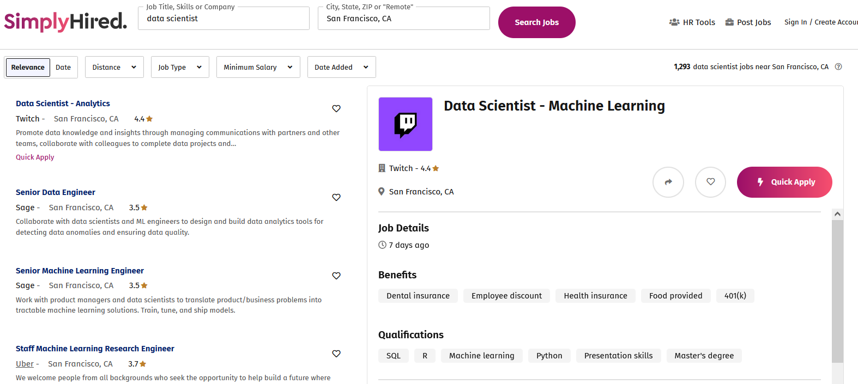
Approach
Data Collection
How were we going to determine the most-valued data science skills?
Notes:
tora

Slide 5
Data Collection
Parameters
Rvest package
Scraping
‘Data Scientist’ title
10 locations: major cities such as NYC, Austin, San Francisco
10 pages per location
19 job posts per page
Attempt to grab each job post’s salary and qualifications
Data set: 1900 job posts
Notes:
tora

Slide 6
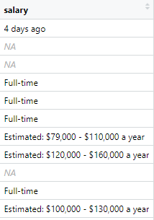
Imperfect Data
Many job posts were missing salary data
Almost 1% had NA values
Many had irrelevant values like “Full-time”
Missing qualifications
So few that these job posts were simply dropped.
Notes:
tora

Slide 7

Imperfect Data: Duplication and Skills by industry
Problems with Data Scraping
Depends on site structure
Ex: Theladders.com
The site allows for duplicate postings from the same employer
Results:
Distortion in term count and skills
Found popular terms like fizzle and pop come from one employer alone
There were 39 openings for data scientists for the “Guitar Center” which distorted skills by industry for Media
Notes:
tora

Slide 8
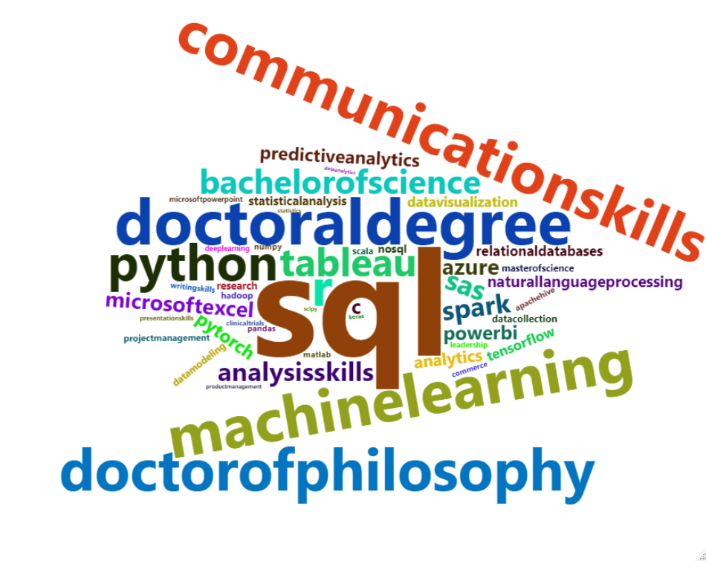
Top 50 Skills
Notes:
tora

Slide 9
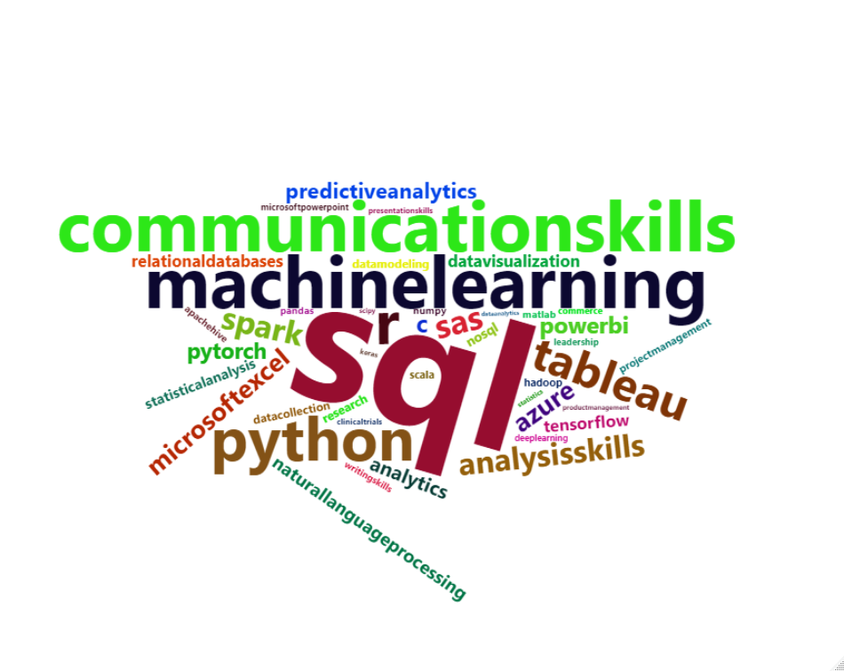
Top 50 Skills - excluding degrees
Notes:
tora

Slide 10
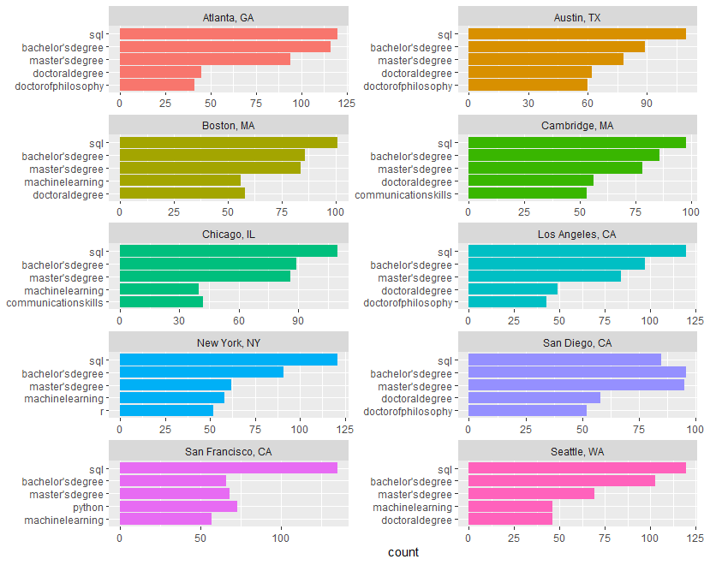
Skills across locations
Notes:
tora

Slide 11
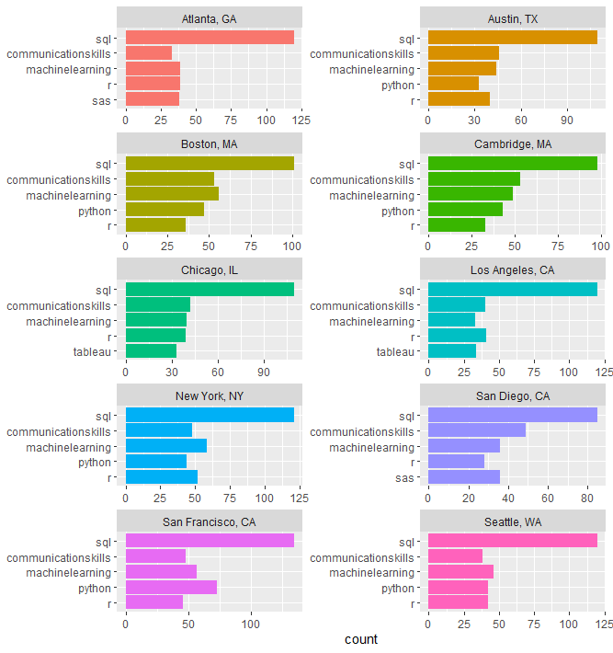
After filtering out degree qualifications…
Notes:
tora

Slide 12
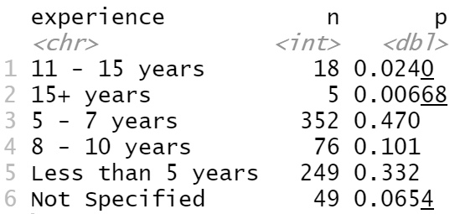
Average experience required for postings
Use word frequency and count
The average experience across posting in 5-7 years
Notes:
Vy
Another analysis we taken partake for our first data set in average experience required by the postings
I use dpylr to create a sub data frame based on the frequencies of each range and mutuate two rows to show the total count and frequency of the experience. We uncover 5-7 year was the most frequent requirement for posters

Slide 13
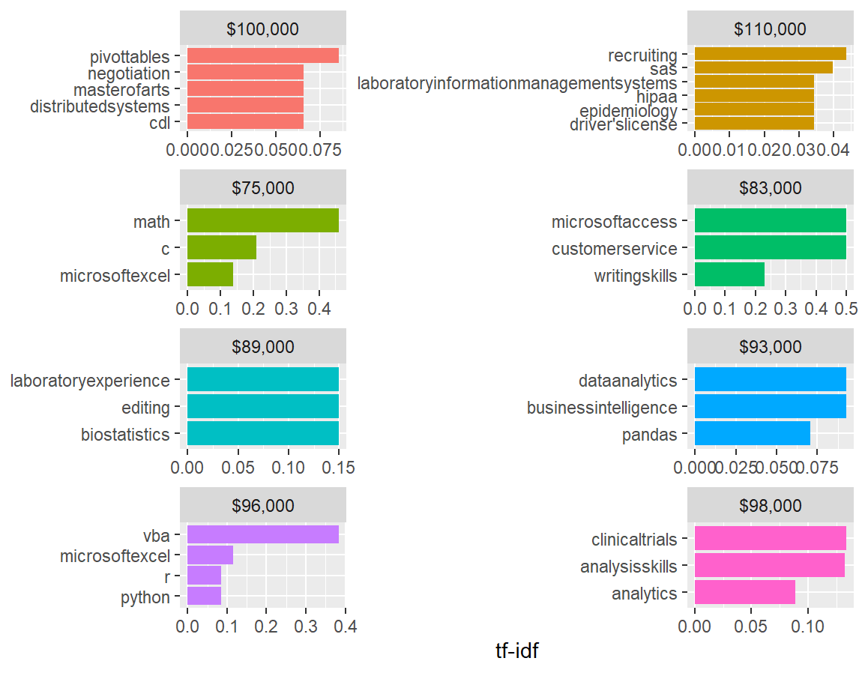
Most relevant Skills based on Salary (low)
Higher Salary postings required more DS skills like distributed systems and another management skills
Some prominent salaries seem involved in the sciences with Lab related terms and Lab experience
Notes:
Vy
The next analysis was seeing a correlation between desired skills and salary. Using tidytext we grouped common terms by their estimated salaries. Then, We sergerate the large variety of max salaries into two groups: low and high. (Read bullet)

Slide 14
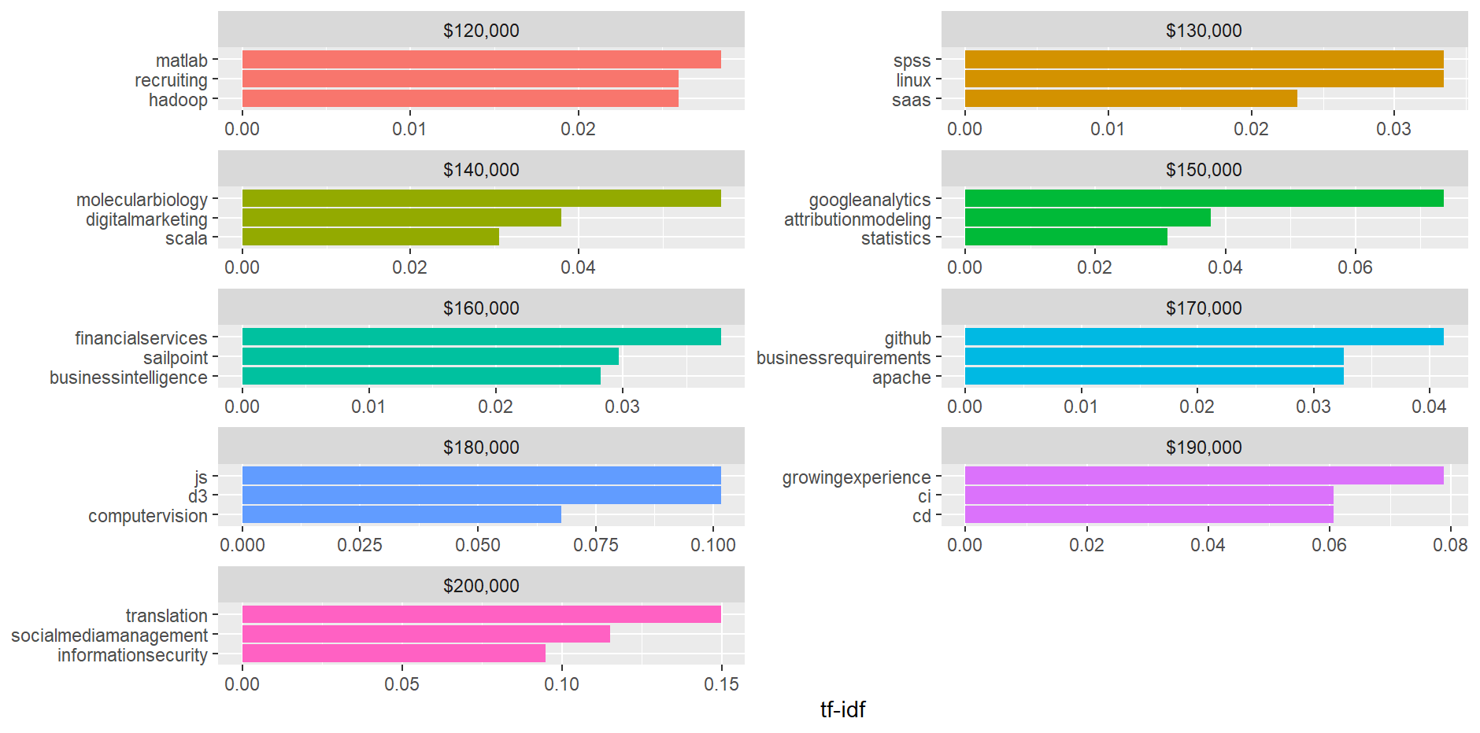
Most relevant skills based on salary (high)
For higher Salaries require more hard DS programming
Database/ algorEquipmentthm creation
There were more requirements for AI knowledge
Computer vision or predictive analysis
Notes:
Vy
Again for

Slide 15
Takeaways
Site Optimization is important in Web Scraping
Quality of the collection decreases instances of duplication
Less structure-> longer scrapping times and higher CPU
Use of the tdf_Id uncovers frequency of a word
Possibilities of analyzing term frequency
Cons of tdf_id for term analyze
Cannot identify origins of popular terms with limited grouping
Notes:
vy

Slide 16
Sources
https://www.ibm.com/blogs/ibm-training/ibm-data-science-careers-future/
https://www.calu.edu/academics/undergraduate/bachelors/data-science/jobs-career-salaries.aspx
Notes:
Vy close

Slide 17
Thanks for your time!

